Slide 1

UNIVERSITI TEKNOLOGI MALAYSIA
SECP3623 - DATABASE PROGRAMMING
2025/2026 - SEM 1
Lab Assignment 1 (5%) - Indexes
Name | : | ELIJAH SHE YU SHENG
Matric Id | : | A23CS0073
Name | : | CHUA JIA LIN
Matric Id | : | A23CS0069
Name | : | CHERYL CHEONG KAH VOON
Matric Id | : | A23CS0060

Slide 2

UNIVERSITI TEKNOLOGI MALAYSIA
B-TREE INDEXES
SECTION 2 - GROUP 4

Slide 3
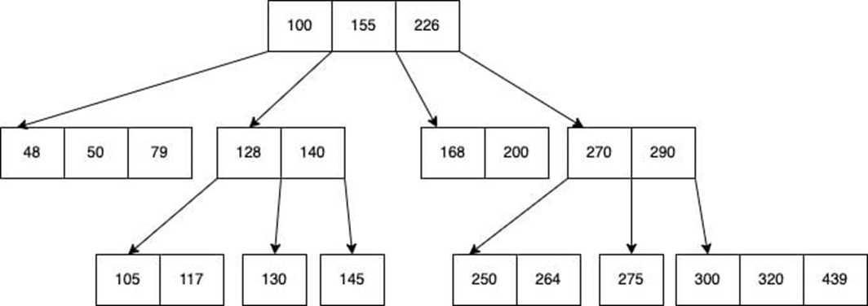
What is B-Tree index?
B-tree stores sorted data for fast search, insert, and delete.
Used in systems that handle large data blocks.
Each node can have multiple keys (not just two).
Keys in a node are stored in ascending order.
Left child < key < right child rule applies.
A node with n keys can have up to n + 1 children.

Slide 4
Advantages, Disadvantages & Comparison
Fast searching, insertion, and deletion : operations are efficient (O log n).
Sorted data access : supports both random and sequential access.
Balanced structure : keeps data evenly distributed, avoiding long branches.
Slower for small datasets : overhead may not be worth it.
More complex to maintain than simple indexes.
Higher memory and storage use : needs extra space for tree structure.
B-tree vs Bitmap: B-tree is better for frequent updates; Bitmap is better for columns with few distinct values.
B-tree vs Text/Full-text: B-tree is for exact or range lookups; Full-text is for word or phrase searches.
B-tree vs Multicolumn: B-tree handles single-column well; Multicolumn optimizes combined-column queries.
B-tree vs Unique: B-tree focuses on speed; Unique adds value uniqueness enforcement.

Slide 5
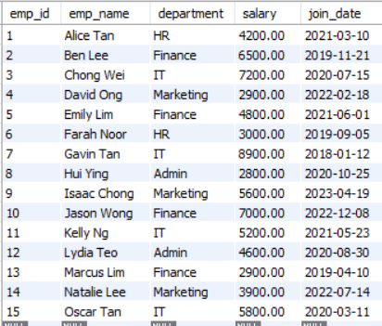
Insert 15-20 Rows of Employee Data:
INSERT INTO employee(emp_id, emp_name, department, salary, join_date) VALUES
(1, 'Alice Tan', 'HR', 4200.00, '2021-03-10'),
(2, 'Ben Lee', 'Finance', 6500.00, '2019-11-21'),
(3, 'Chong Wei', 'IT', 7200.00, '2020-07-15'),
(4, 'David Ong', 'Marketing', 2900.00, '2022-02-18'),
(5, 'Emily Lim', 'Finance', 4800.00, '2021-06-01'),
(6, 'Farah Noor', 'HR', 3000.00, '2019-09-05'),
(7, 'Gavin Tan', 'IT', 8900.00, '2018-01-12'),
(8, 'Hui Ying', 'Admin', 2800.00, '2020-10-25'),
(9, 'Isaac Chong', 'Marketing', 5600.00, '2023-04-19'),
(10, 'Jason Wong', 'Finance', 7000.00, '2022-12-08'),
(11, 'Kelly Ng', 'IT', 5200.00, '2021-05-23'),
(12, 'Lydia Teo', 'Admin', 4600.00, '2020-08-30'),
(13, 'Marcus Lim', 'Finance', 2900.00, '2019-04-10'),
(14, 'Natalie Lee', 'Marketing', 3900.00, '2022-07-14'),
(15, 'Oscar Tan', 'IT', 5800.00, '2020-03-11');

Slide 6
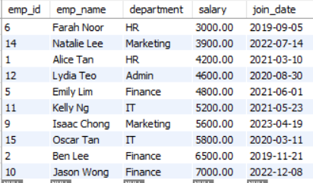
Add a B-Tree index on salary:
Execute and record query time:
CREATE INDEX idx_salary ON employee(salary);
SELECT * FROM employee WHERE salary BETWEEN 3000 AND 7000;
Query time: 0.000 sec

Slide 7
Add an index on join_date and compare range query performance
Execute and record query time:
CREATE INDEX idx_join_date ON employee(join_date);
Condition | Query Time | key (EXPLAIN) | rows scanned
Without index | 0.000 sec | NULL | 15
With index | 0.000 sec | idx_join_date | 4
SELECT *
FROM employee
WHERE join_date BETWEEN '2022-01-01' AND '2024-12-31';

Slide 8
Use EXPLAIN to confirm index usage
Execute and record query time:
EXPLAIN SELECT *
FROM employee
WHERE join_date BETWEEN '2022-01-01' AND '2024-12-31';
Without Index：
With Index：
After adding the index, EXPLAIN shows key = idx_join_date and fewer rows scanned.
This confirms that MySQL used the B-Tree index to perform a range scan, decreasing the amount of data accessed.

Slide 9
Drop Index & Re-run Query
Re-run range query
DROP INDEX idx_join_date ON employee;
SELECT *
FROM employee
WHERE join_date BETWEEN '2022-01-01' AND '2024-12-31';
Query time: 0.000 sec
After removing the index, the same query still shows 0.000 sec due to the small dataset.
However, EXPLAIN indicates key = NULL and more rows scanned, meaning MySQL must perform a full table scan. This proves that without the index, MySQL becomes less efficient and must check more rows to fulfill the condition.

Slide 10
Discuss why B-Tree is ideal for range & sorting?
B-Tree indexes store values in sorted hierarchical order.
When performing range queries, MySQL can quickly navigate to the start of the range and then read sequentially, avoiding full scans.
Because the index is already sorted, sorting operations (e.g., ORDER BY) are faster as no extra sort step is needed.
This makes B-Tree indexes ideal for range filtering and sorting workloads.

Slide 11


THANK YOU
utmofficial
univteknologimalaysia
utm.my

